Slide 1
Career Technical Education & Every Student Succeeds Act
Kate Blosveren Kreamer
January 10, 2018

Slide 2
CTE’s Broad Scope
CTE is an educational option that provides learners with the knowledge and skills they need to be prepared for college, careers and lifelong learning.
CTE gives purpose to learning by emphasizing real-world skills and practical knowledge within a selected career focus.
  From early career exploration to highly technical training
  Includes all sectors and professions

Slide 3
THEN: VOCATIONAL EDUCATION | NOW: CAREER TECHNICAL EDUCATION
  Voc Ed → CTE
For a Few Students | For All Students
For a Few “Jobs” | For All Careers
6 to 7 “Program Areas” | 16 Career Clusters® 79 Career Pathways
In lieu of Academics | Aligns/Supports Academics
High-School Focused | High School and Postsecondary Partnerships
Terminal | Life-long learning

Slide 4
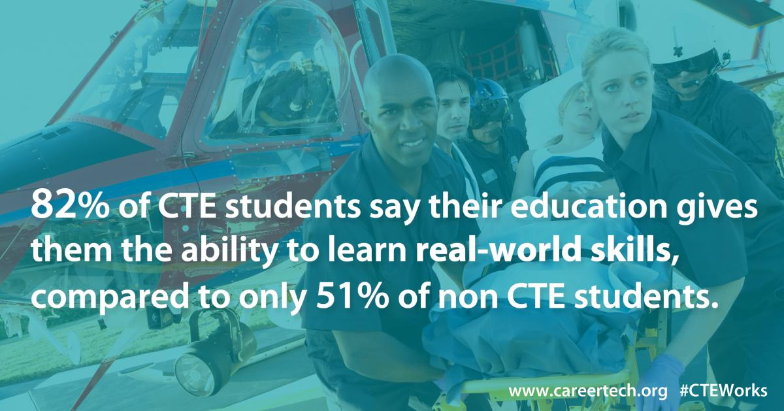

CTE Delivers
www.careertech.org/recruitmentstrategies
93% High school graduation rate for CTE concentrators, compared to 82% average rate | 78% CTE concentrators enrolling in postsecondary education, full time, within two years of graduation. | 84% adult CTE concentrators placed in further education or employment within six months of completing their program.

Slide 5
Quality Program Design & Approval
Core Elements of a CTE Program Approval Policy
Rigorous course standards and progressive, sequenced courses
Secondary and postsecondary alignment and early postsecondary offerings
Industry involvement
Labor market demand
High-quality instruction
Experiential learning
https://careertech.org/resource/program-approval-policy-benchmark-tool

Slide 6
Key Questions to Ask
Does the program of study:
Begin with introductory an course that teaches broad foundational knowledge and skills and progress to more occupationally-specific courses?
Have meaningful and impactful partnerships with secondary/postsecondary institutions and industry partners?
Include opportunities to earn early postsecondary credits (which learners actually earn and transfer)?
Provide meaningful work-based learning opportunities?
Have labor market relevance?
Serve disadvantaged and/or nontraditional students being reached proportionate to the broader community’s population?
Have a qualified instructor teaching learners?
Culminate or prepare students for a credential of value?

Slide 7
Every Student Succeeds Act

Slide 9
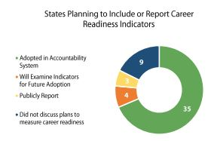
Title I: Accountability
35 states measuring career readiness in their ESSA accountability systems
Marks a 75% increase from before ESSA

Slide 10
Title I: School Improvement
States are required to identify the five percent of schools lowest performing and offer strategies for improvement.
Five states identified expansion of CTE or pathways as a critical support opportunity for low performing schools

Slide 11
Title II, Part A: Supporting Effective Instruction
Supports professional development for teachers, leaders and administrators
Can be used to provide training on integrating academic and CTE instructional strategies as well as understanding and using labor market data
11 states identified opportunities, but plans were light on details

Slide 12
Title IV, Part A: SSAE Grants
Student Support and Academic Enrichment grants (SSAE) support access to a “well-rounded education”
Two-thirds of states reinforced the idea that a “well-rounded education” should include CTE, STEM or dual enrollment
However, only 15 described specific state-level activities to support this work

Slide 13
Title IV, Part B: 21st Century Community Learning Centers
21st Century Community Learning Centers support after school learning
20 states prioritize career readiness in 21st CCLC grant guidelines

Slide 14
Where to Lean in
Reporting of accountability indicators
Role of industry and community members in local needs assessment
Supports/interventions for low-performing schools
Focus and quality of 21st Century Community Learning Centers

Slide 15
CTE & Equity

Slide 16
CTE vs All Students

Slide 17
Equity Challenges
Islands of excellence rather than continents of quality
Legacy
Teacher shortage
Limited data and accountability under Perkins (but new opportunities under ESSA)

Slide 18
Questions?
Kate Kreamer
Deputy Executive Director, Advance CTE
kkreamer@careertech.org

