Slide 1

Inclusion of Subgroups in ESSA Accountability Systems
@all4ed

Slide 2




NCLB
ESSA

Slide 3




@all4ed
Images depicting 15 years ago
Blackberry (instead of iphone)
Twitter did not exist
Pumpkin Spice Latte was first invented
Notes:
Last time states were going through this comprehensive planning process was 15 years ago – under No Child Left Behind.
Things looked different 15 years ago – we were using blackberries instead of iPhones (and exploding Samsungs); Twitter did not exist; and 15 years marks anniversary of pumpkin spice latte (Starbucks)
So when we think about the importance of this moment – plans states are developing today could easily be in effect for the next 15 years.

Slide 4


Notes:
That means that today’s kindergarteners may graduate high school while these plans are still in effect.

Slide 5

The Rising Majority
Total U.S.
African American
public-school enrollment increased by
3.1%
between 1995
to 2015
Over 50% of public school students are from low-income families and/or are students of color.
Courtesy of Allison Shelley/The Verbatim Agency for American Education: Images of Teachers and Students in Action.
Source: Poverty: https://nces.ed.gov/programs/digest/d17/tables/dt17_204.10.asp?current=yes
Race: https://nces.ed.gov/programs/digest/d17/tables/dt17_203.50.asp?current=yes

Slide 6
The Rising Majority
Latino enrollment in public schools increased by
115%
from 1995
to 2015
Courtesy of Allison Shelley/The Verbatim Agency for American Education: Images of Teachers and Students in Action.
Source: Poverty: https://nces.ed.gov/programs/digest/d17/tables/dt17_204.10.asp?current=yes
Race: https://nces.ed.gov/programs/digest/d17/tables/dt17_203.50.asp?current=yes

Slide 7
The Rising Majority
Total U.S.
Two-or-more race
public-school enrollment increased by
48%
between 2010
to 2015
Source: Poverty: https://nces.ed.gov/programs/digest/d17/tables/dt17_204.10.asp?current=yes
Race: https://nces.ed.gov/programs/digest/d17/tables/dt17_203.50.asp?current=yes

Slide 8
The Rising Majority
Total U.S. white public-school enrollment decreased by
15%
between 1995
to 2015
Courtesy of Allison Shelley/The Verbatim Agency for American Education: Images of Teachers and Students in Action.
Source: Poverty: https://nces.ed.gov/programs/digest/d17/tables/dt17_204.10.asp?current=yes
Race: https://nces.ed.gov/programs/digest/d17/tables/dt17_203.50.asp?current=yes

Slide 9





Slide 10
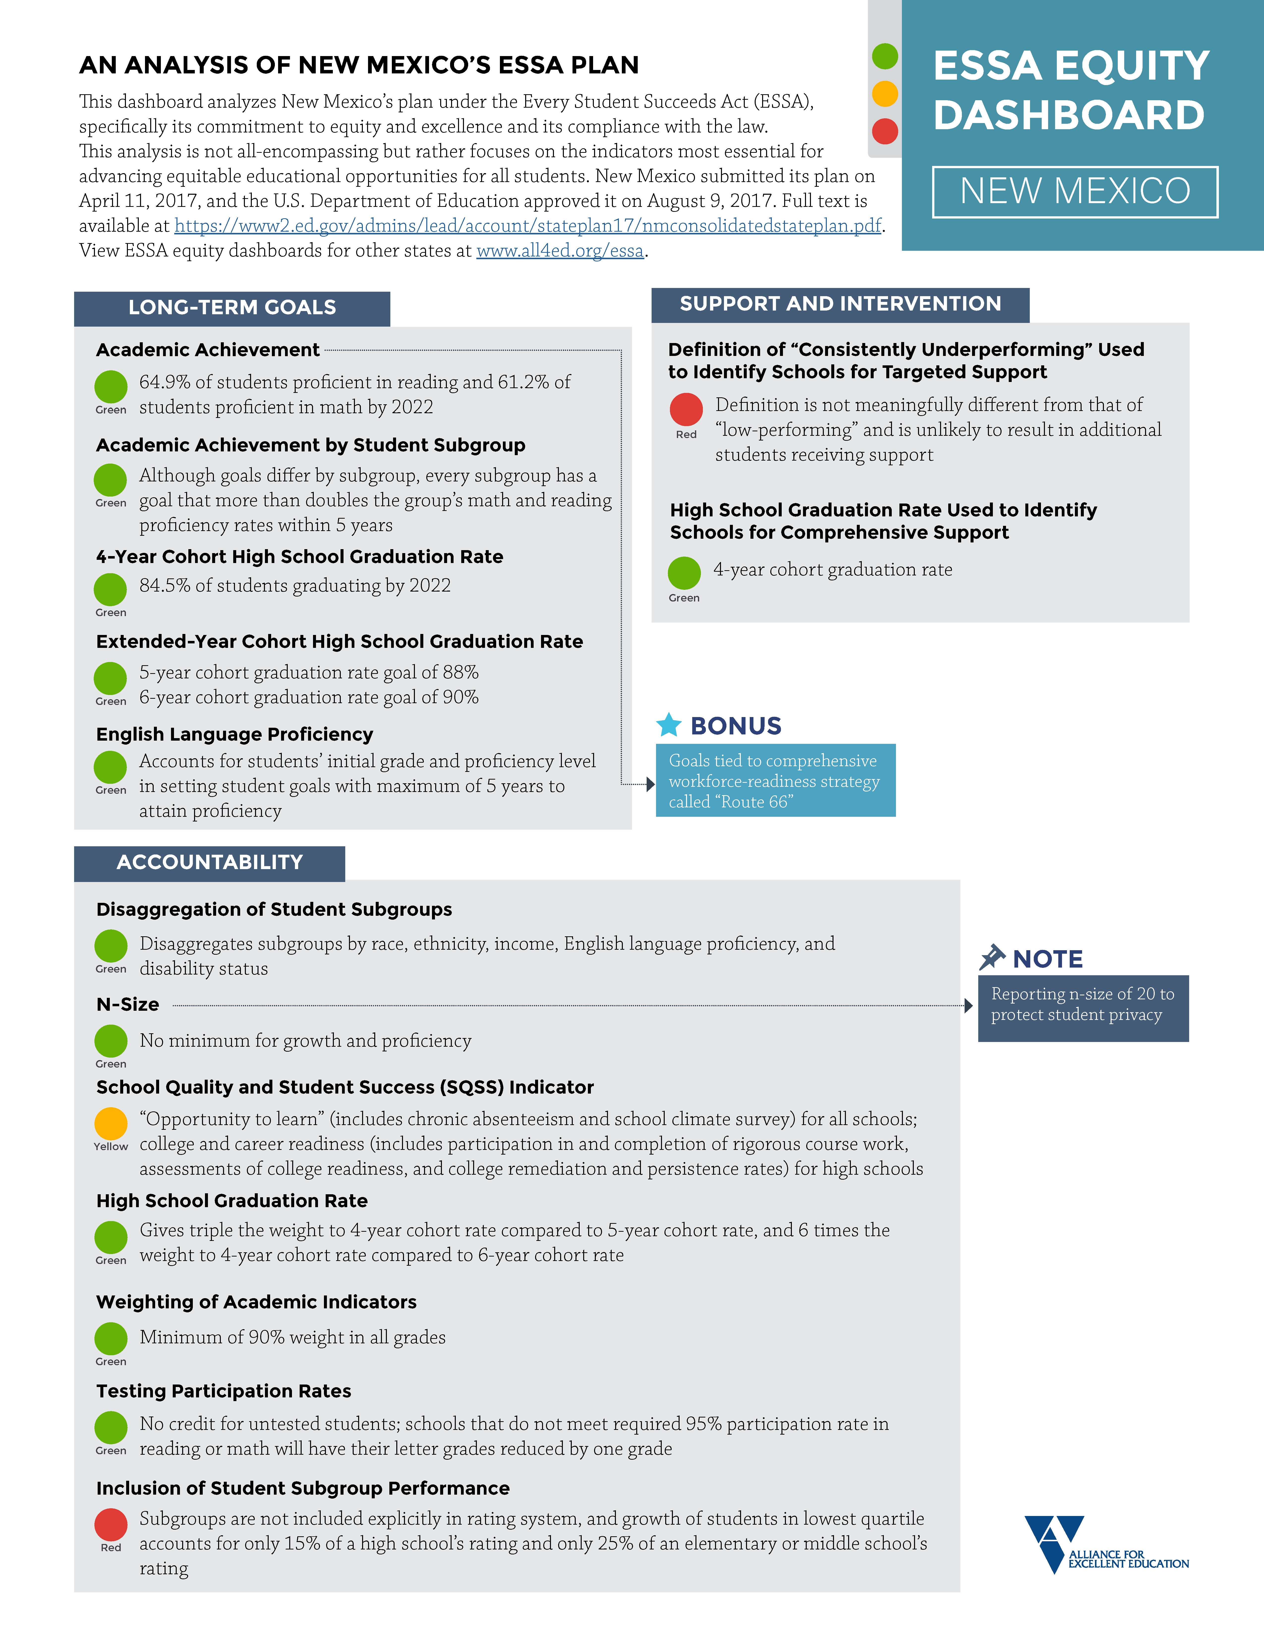
Equity Dashboards
Each state’s ESSA plan evaluated on 14 equity indicators
States receive a red, yellow, or green rating on each indicator
Areas examined include long-term goals, state-selected accountability indicators and their respective weights, the inclusion of subgroups, school identification, and more
https://all4ed.org/essa/essa-in-your-state

Slide 11
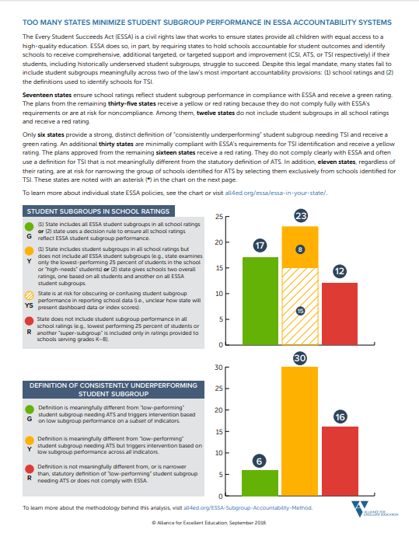
Equity Dashboards
Do historically underserved students count in school ratings?
Will schools be identified for support if historically underserved students consistently underperform?

Slide 12
Inclusion of Subgroups in Ratings
ESSA requires states to disaggregate every indicator in their accountability systems and include subgroups in school ratings
Required subgroups: major racial/ethnic groups, low-income students, English learners, and students with disabilities
“Establish a system of meaningfully differentiating, on an annual basis, all public schools in the State, which shall –
(i) be based on all indicators in the State’s accountability system under subparagraph (B),
for all students and for each subgroup of students,
consistent with the requirements of such subparagraph.”
[ESSA, Section 1111(c)(4)(C)(i)]

Slide 13
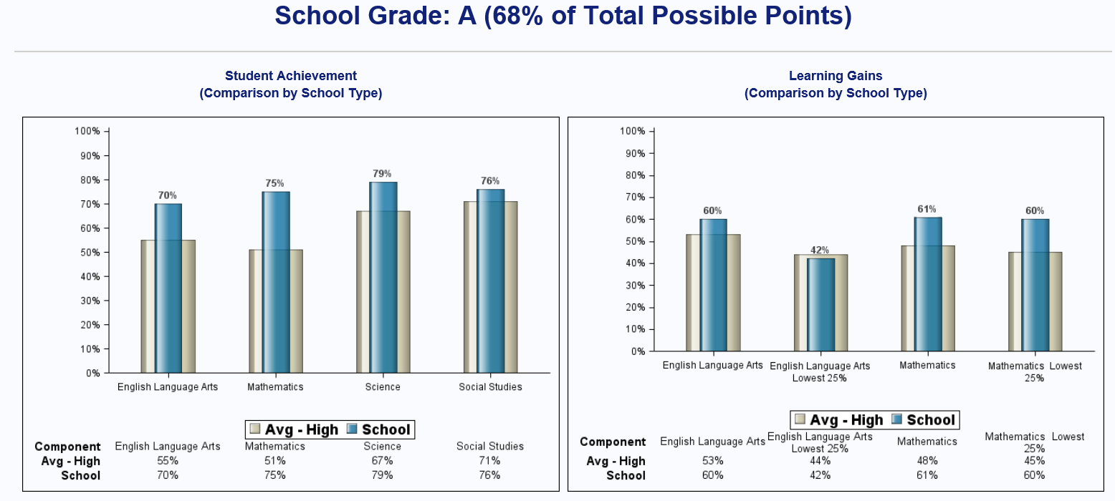

Slide 14
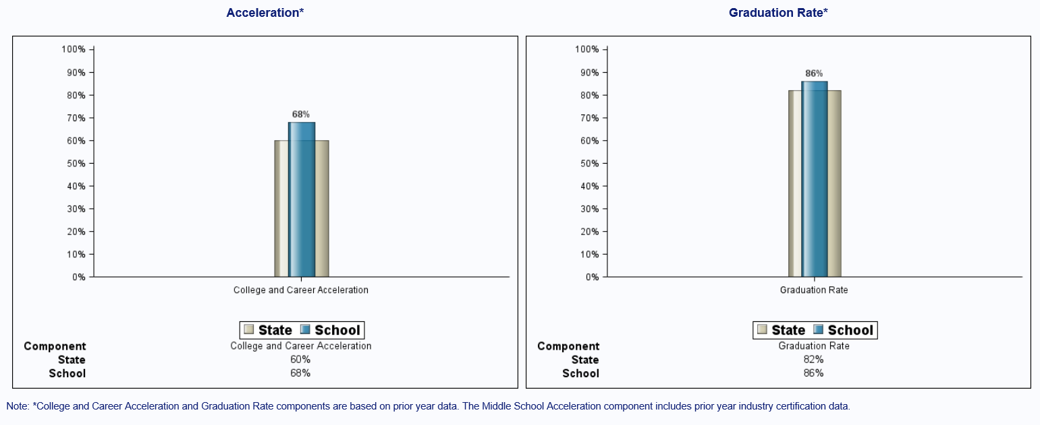

Slide 15
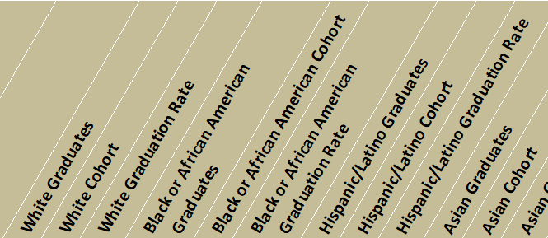
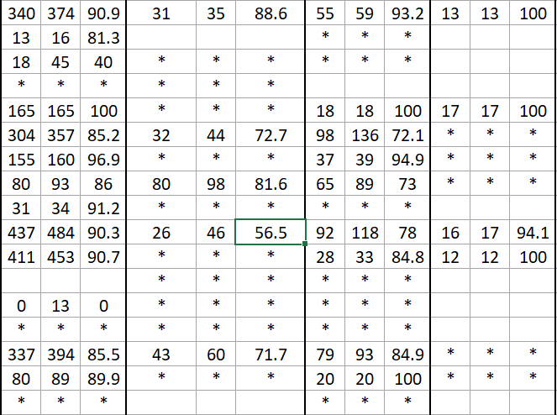
What is the graduation rate for
African American students?

Slide 16
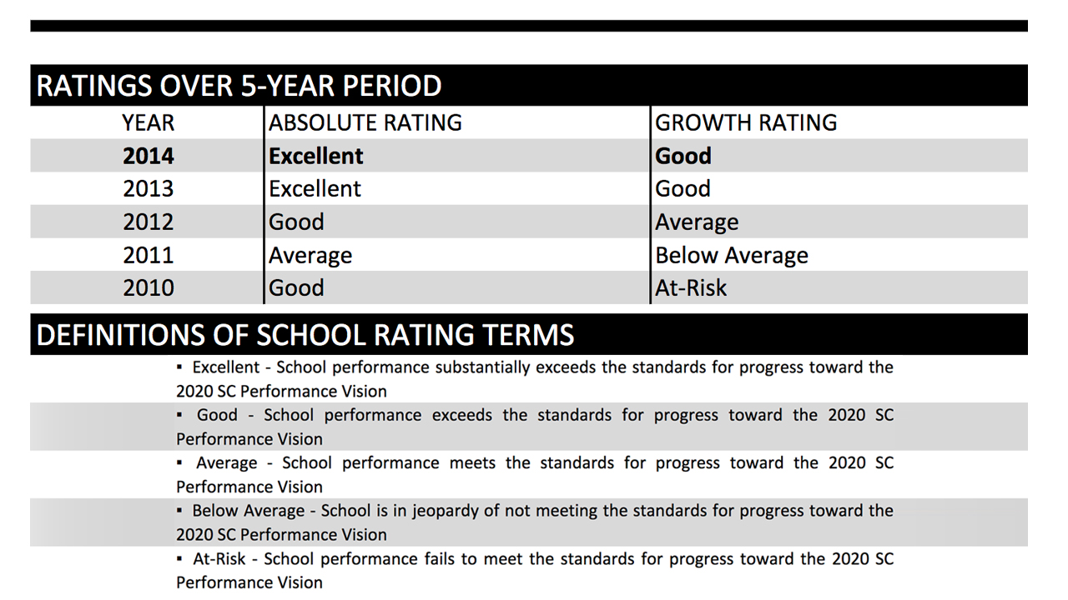

Slide 17
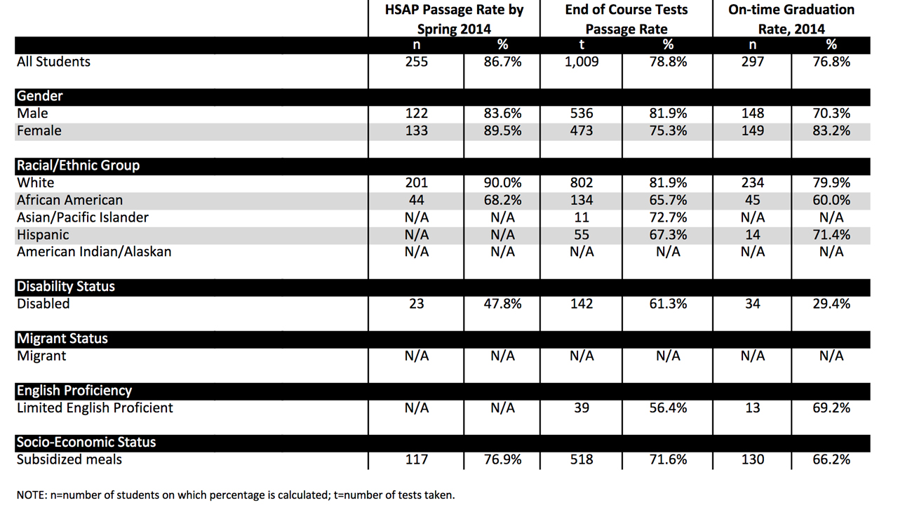

Slide 18
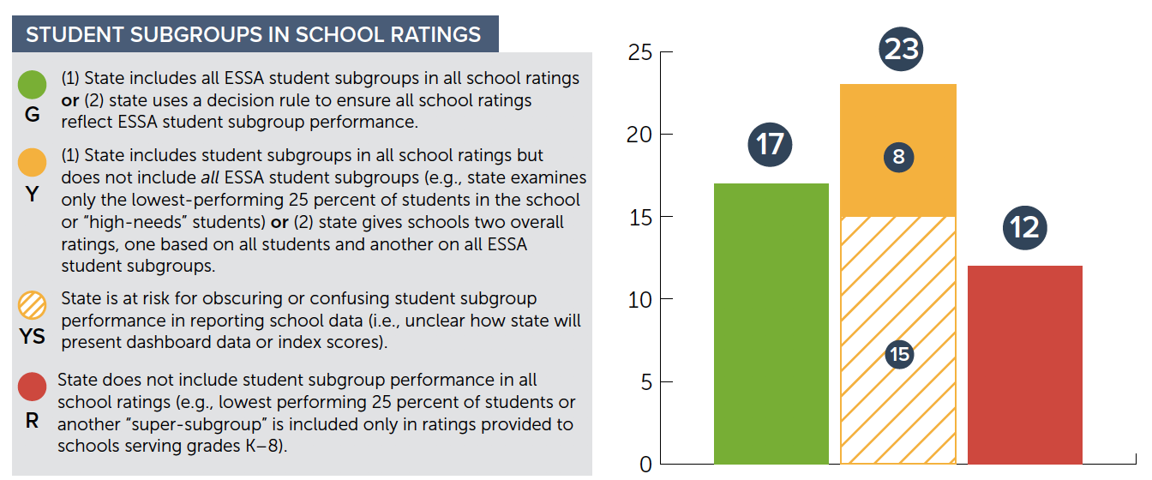
Inclusion of Subgroups in Ratings

Slide 19
Inclusion of Subgroups in Ratings
The 12 red states exclude ESSA subgroups in calculating some, or all, school ratings.

Slide 20
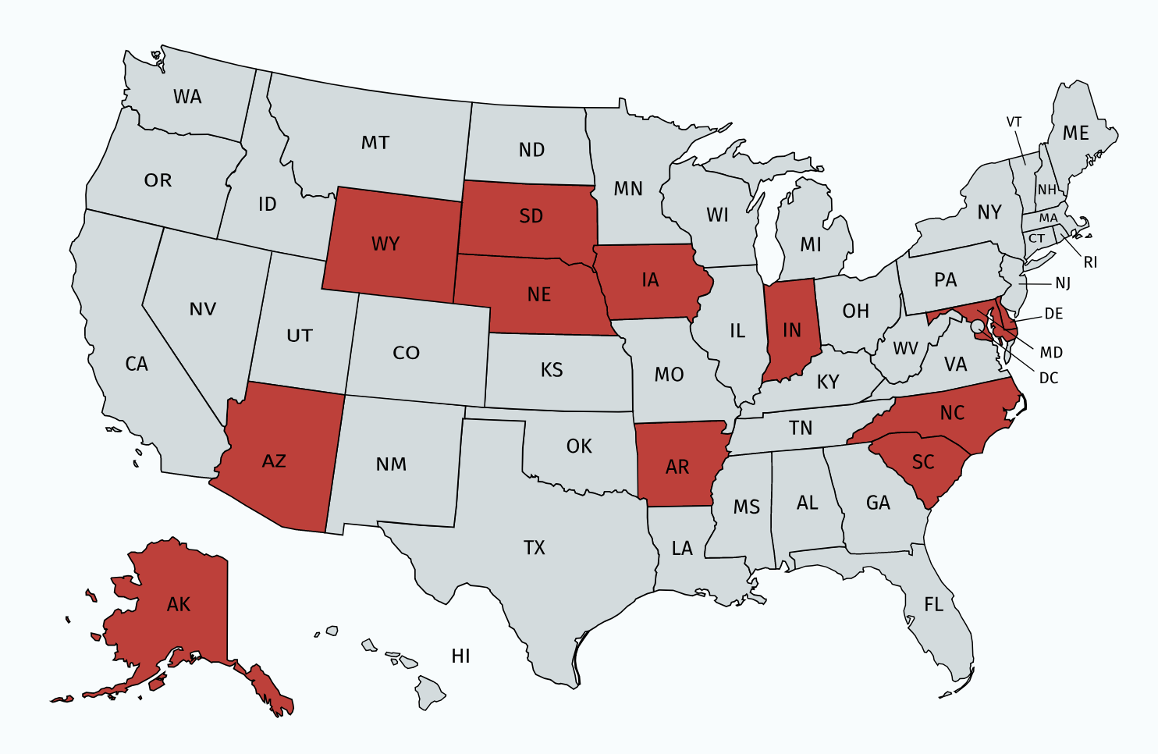
Red States: Ratings
Alaska
Arizona
Arkansas
Delaware
Indiana
Iowa
Maryland
Nebraska
North Carolina
South Carolina
South Dakota
Wyoming

Slide 21
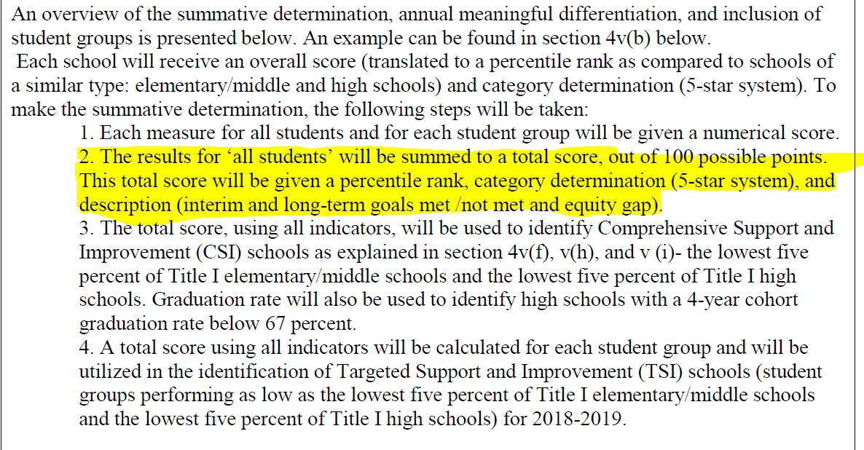
Example: Maryland
Source: MD ESSA Plan, page 31
(http://bit.ly/MDessaplan)
Notes:
MD: None of the indicators that make up its school star ratings include subgroup performance

Slide 22
Inclusion of Subgroups in Ratings
The 17 green states include all ESSA subgroups in calculating all school ratings (i.e., they get a specific weight) or use a decision rule to ensure low subgroup performance affects ratings on the back-end.
  GA: Closing Gaps indicator measures all ESSA subgroups and receives 10-15% of the weight (varies by grade span)
  RI: Schools with low-performing subgroups cannot receive the top ratings

Slide 23
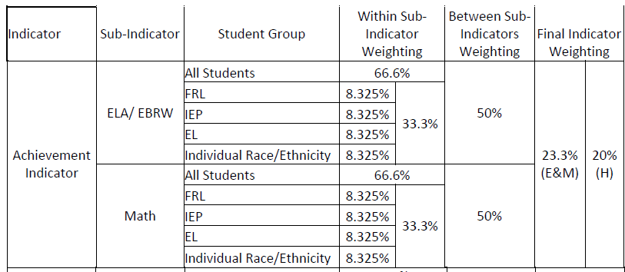
Who’s doing it right?
Colorado
Notes:
Green: Schools receive lower rating if they have a struggling
subgroup or subgroup performance is an independent and
substantial portion of rating index
Yellow: Subgroups have lesser but still meaningful effect on a
school’s rating
Red: Subgroups have little to no effect on a school’s rating

Slide 24

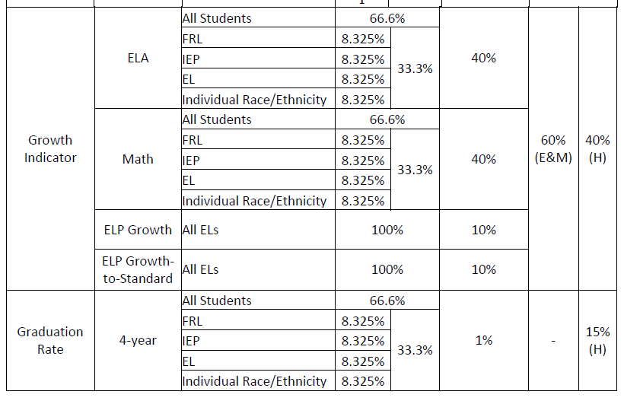
Who’s doing it right?
Source:
Notes:
Green: Schools receive lower rating if they have a struggling
subgroup or subgroup performance is an independent and
substantial portion of rating index
Yellow: Subgroups have lesser but still meaningful effect on a
school’s rating
Red: Subgroups have little to no effect on a school’s rating

Slide 25
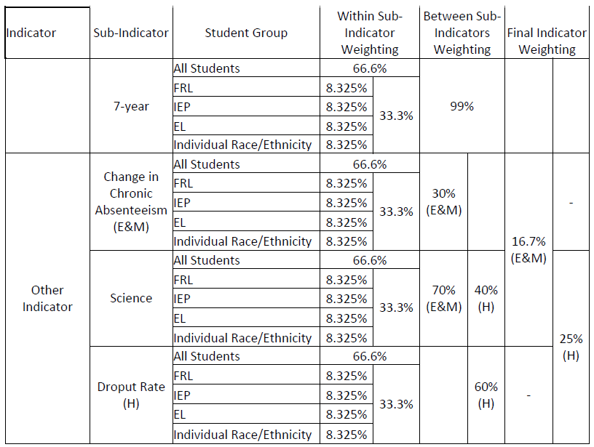
Who’s doing it right?
Source: CO ESSA Plan, pages 80-82
(http://bit.ly/COessaplan)
Notes:
Green: Schools receive lower rating if they have a struggling
subgroup or subgroup performance is an independent and
substantial portion of rating index
Yellow: Subgroups have lesser but still meaningful effect on a
school’s rating
Red: Subgroups have little to no effect on a school’s rating

Slide 26
Inclusion of Subgroups in Ratings
The 8 yellow states include some ESSA subgroups in calculating all school ratings, or the state gives multiple school ratings—one for all students and another for subgroups.
  CT: Several indicators used in school ratings measure a “high-needs” subgroup of all low-income, English learner, and disabled students, but ratings do not examine any major racial/ethnic groups
  VT: Schools receive two ratings, an “Equity Index” for subgroups of students and the “All Students” rating

Slide 27
Inclusion of Subgroups in Ratings
The 15 yellow “striped” states are at risk for obscuring or confusing subgroup performance.
These states typically do not give school ratings and instead use a “dashboard” to convey how schools are doing publicly.
  Whether the overall performance of subgroups in the school relative to “all students” is clear will depend on how the state’s “dashboard” is designed and presented to parents and the public.

Slide 28



Which Schools Are Identified for Support?
1
2
3
Comprehensive Support and Improvement
Lowest-performing 5% of Title I schools
Any high school with graduation rates below 67%
“Additional targeted support” schools that do not improve within a state-set timeline
Additional Targeted Support
Schools with a subgroup performing at the level of the lowest-performing 5% of Title I schools
Targeted School Improvement
Schools with “consistently underperforming” subgroups, as defined by the state
Identified annually, no later than 2019-20
Can be identified once every three years, no later than 2018-19

Slide 29
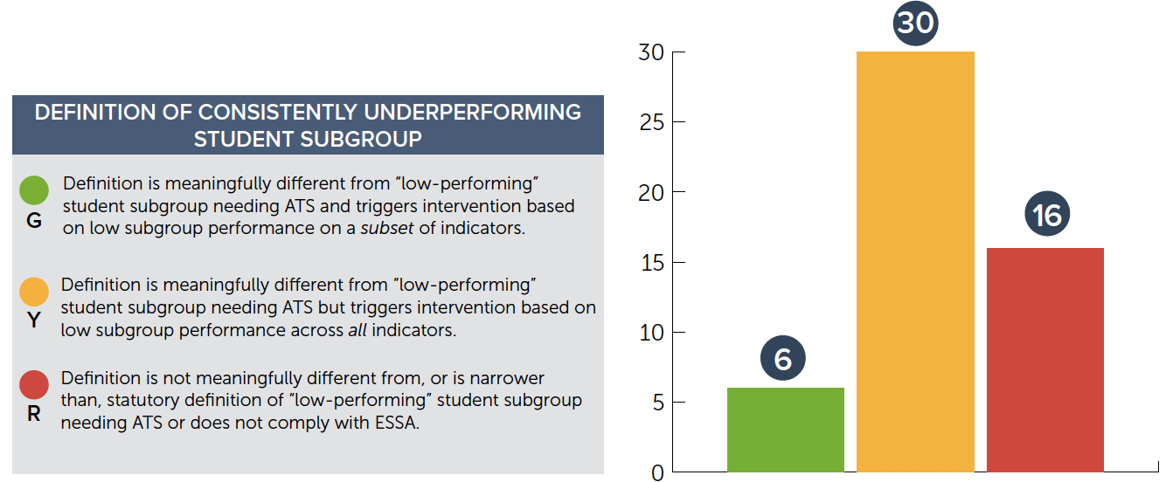
Targeted Support Identification

Slide 30
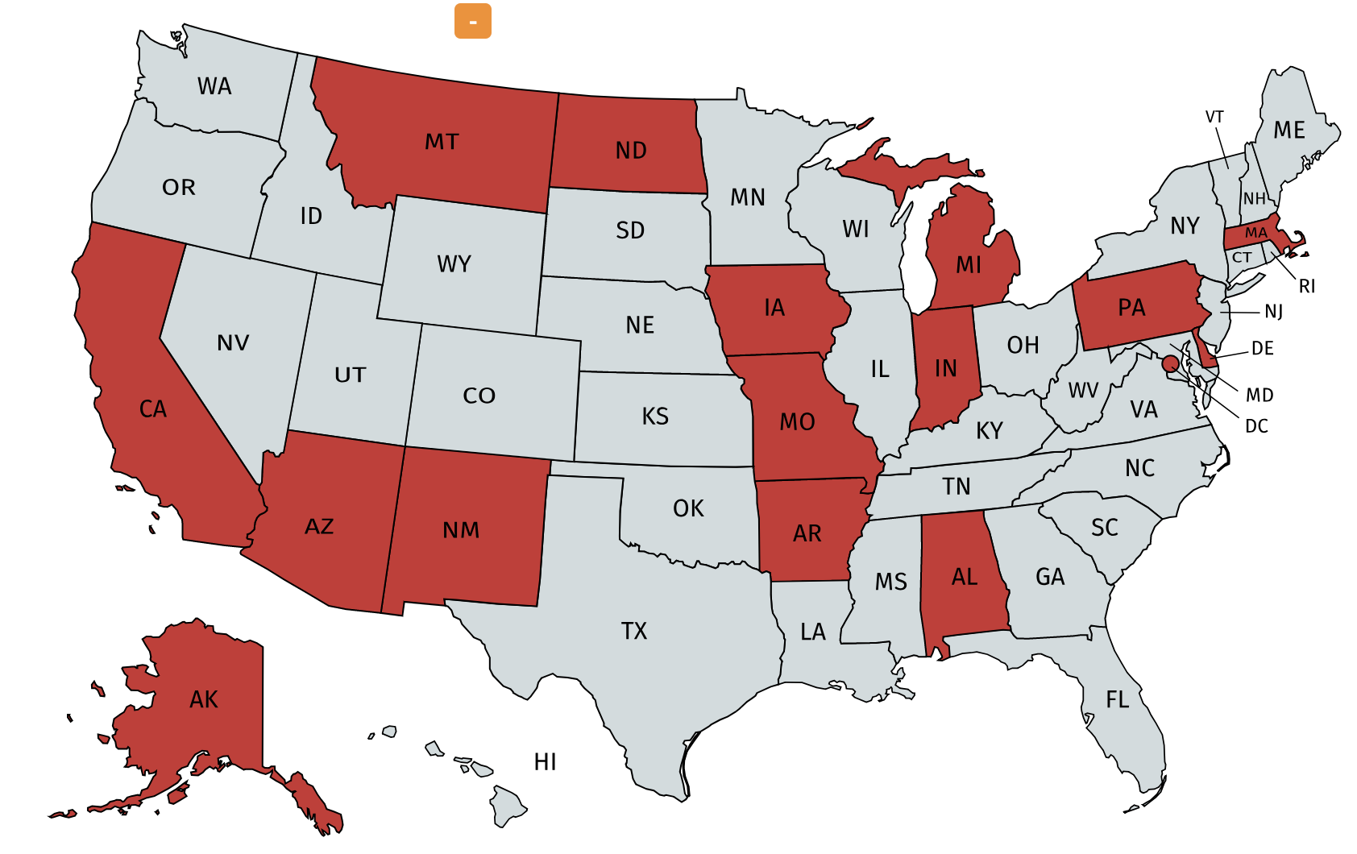
Red States: Consistently Underperforming
Alabama
Alaska
Arizona
Arkansas
California
Delaware
Indiana
Iowa
Massachusetts
Michigan
Missouri
Montana
New Mexico
North Dakota
Pennsylvania
Washington, DC

Slide 31
Targeted Support Identification
The 16 red states use a definition of consistently underperforming subgroup needing targeted support (TSI) that is not meaningfully different, or is narrower, than ESSA’s definition of a subgroup needing additional targeted support (ATS).
  These states are most likely to under-identify schools with low-performing subgroups, because their definitions for TSI will not capture additional schools.

Slide 32
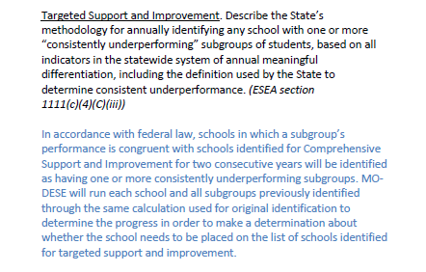
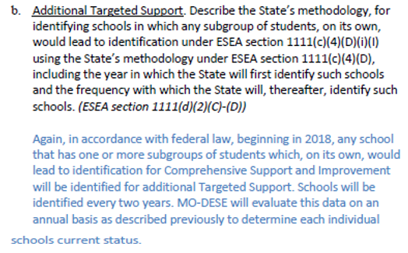
Example: Missouri
Source: Missouri ESSA Plan, Pages 30-31 (http://bit.ly/MOessaplan)

Slide 33
Targeted Support Identification
The 6 green states use a definition of consistently underperforming subgroup needing TSI that is meaningfully different than ESSA’s definition of a subgroup needing additional targeted support (ATS), and the state ensures a subgroup struggling on a subset of indicators can be identified for TSI.

Slide 34
Who’s doing it right? Nevada
Nevada identifies schools as follows:
  TSI: Any school that misses improvement targets in reading or math for a subgroup for two years in a row, OR that misses performance targets on two other indicators (graduation rates, growth, ELP, student success) for two years in a row.
  ATS: Any school doing as badly for a student group as CSI schools are doing for all students.
Source: Nevada ESSA Plan, Pages 65-67 (http://bit.ly/NVessaplan)

Slide 35
Targeted Support Identification
The 30 yellow states use a definition of consistently underperforming subgroup needing TSI that is meaningfully different than ESSA’s definition of a subgroup needing additional targeted support (ATS), but the definition considers whether subgroups are struggling across all of the indicators in determining whether the school should be identified for TSI.

Slide 36

Resources
www.all4ed.org/federal-flash
https://all4ed.org/essa/essa-in-your-state
@all4ed

Slide 37
Contact
Phillip Lovell
Vice President
Policy Development and Government Relations
202-642-4979
Plovell@all4ed.org
@pdclovell
@all4ed

